Slide 1

Big Game Census Analytics
Created By
Harshita Choubey

Slide 2

Introduction
Created an engaging data visualization that highlights the geographic diversity of Super Bowl rosters by mapping player birthplaces against state population figures, fostering a deeper understanding of player origins and population demographics.
Integrate interactive elements such as embedded links to additional census data points, allowing users to explore related information and gain insights into broader societal trends beyond football.
Utilize data from credible sources such as census.gov and sports platforms like Yahoo Sports, ensuring accuracy and reliability in presenting the information and encouraging informed analysis and enjoyment of the visualization.

Slide 3
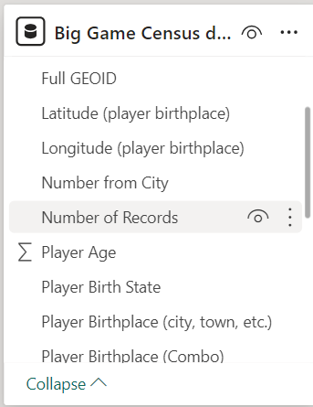
Details of dataset
The dataset from the Big Game Census includes player counts from various cities, showcasing the geographic diversity of Super Bowl participation across multiple urban centers. It also provides insights into player ages, birth states, birthplaces, and positions, offering a comprehensive view of the players' backgrounds and roles within the game.

Slide 4
Main KPIs
“
Player Team
Player Birth State
Player Name
Player Age
Player Position
”

Slide 5
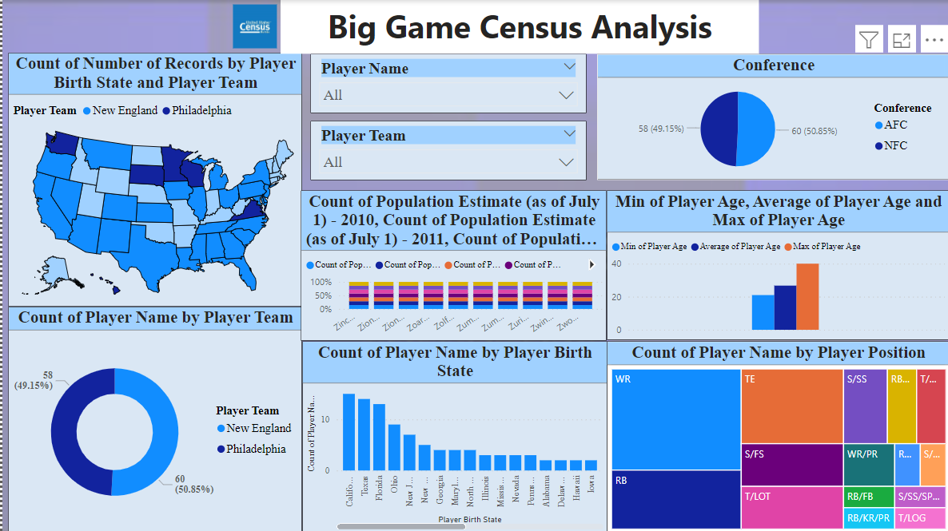
My Design
B2B market scenarios​
Develop winning strategies to keep ahead of the competition
Capitalize on low-hanging fruit to identify a ballpark value
Visualize customer directed convergence
Cloud-based opportunities
Iterative approaches to corporate strategy
Establish a management framework from the inside

Slide 6

Thank you

